Slide 1

Capstone Project
Presented by: Desaree Byers

Slide 2


Client Details
The client works with building owners and property management companies across the nation.
They are currently working with a client in California and are looking to install an access card system building-wide.

Slide 3
Project Details
8 Floors
7 different businesses
30 employees total
Functionality
Growing area
Ease of use
Security
Security clearance
Security assurance

Slide 4
Building Application
DTO’s and DAO’s
Controllers
Service Layer
Step 1
Step 2
Build DTO’s and DAO’s
Build Controllers
Build Service Layer
Step 3

Slide 5
Two content layout with table
Fill in tables in mySQL
Test API routes in Postman
Build tests
mySQL
Postman
Testing

Slide 6

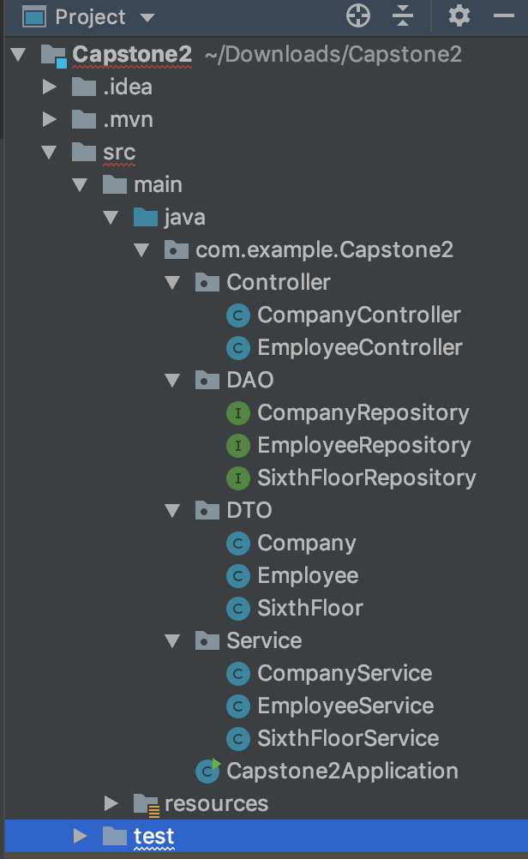
Project Set-Up

Slide 7
Application Demonstration

Slide 8
Application Status
Fulfilled
Not Fulfilled
DTO’s and DAO’s
API routes(tested through Postman)
Service layer with logic
Testing for service layer

Slide 9
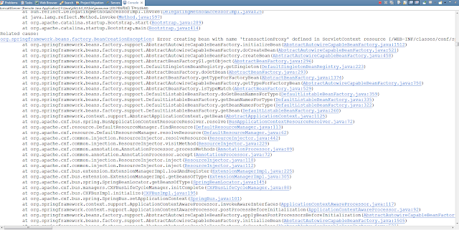
Challenges
→BEAN CREATION EXCEPTION

Slide 10
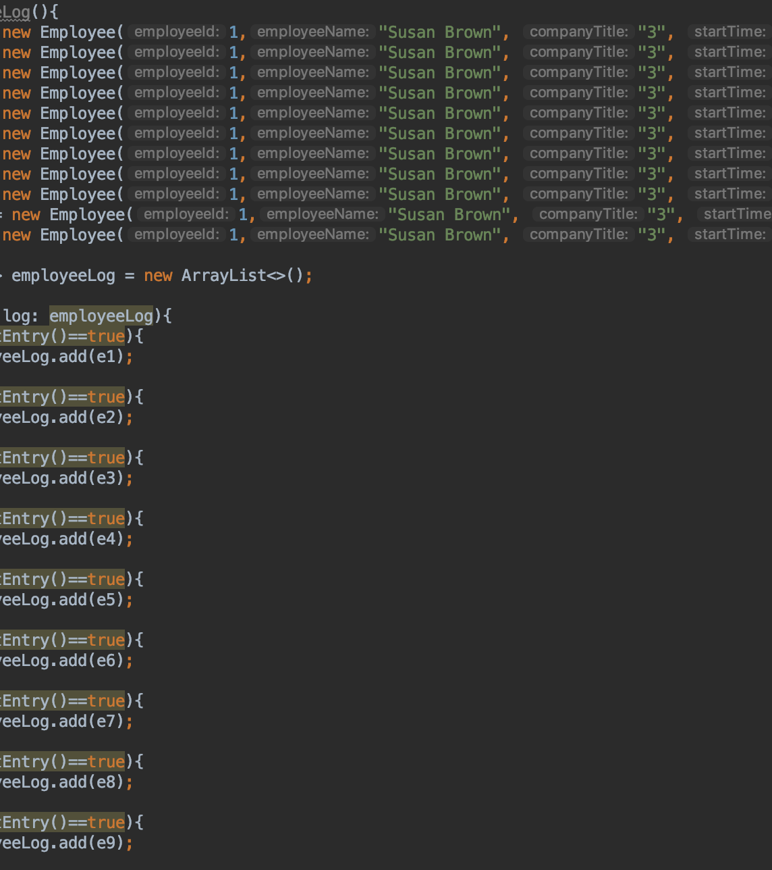
Improvements
→ LOG CREATION

Slide 11
QUESTIONS?

